Slide 1
Automating Checkout Process in Retail
Final Internship Presentation
Vamsi Krishna Pirati

Slide 2
Introduction
Manual product recognition is labour-intensive and prone to errors.
This project uses YOLOv11 to automate the checkout process in retail.
Objectives:
Real-time object detection.
Fine-grained product recognition.
Overcome challenges like domain shifts and dataset imbalance.

Slide 3
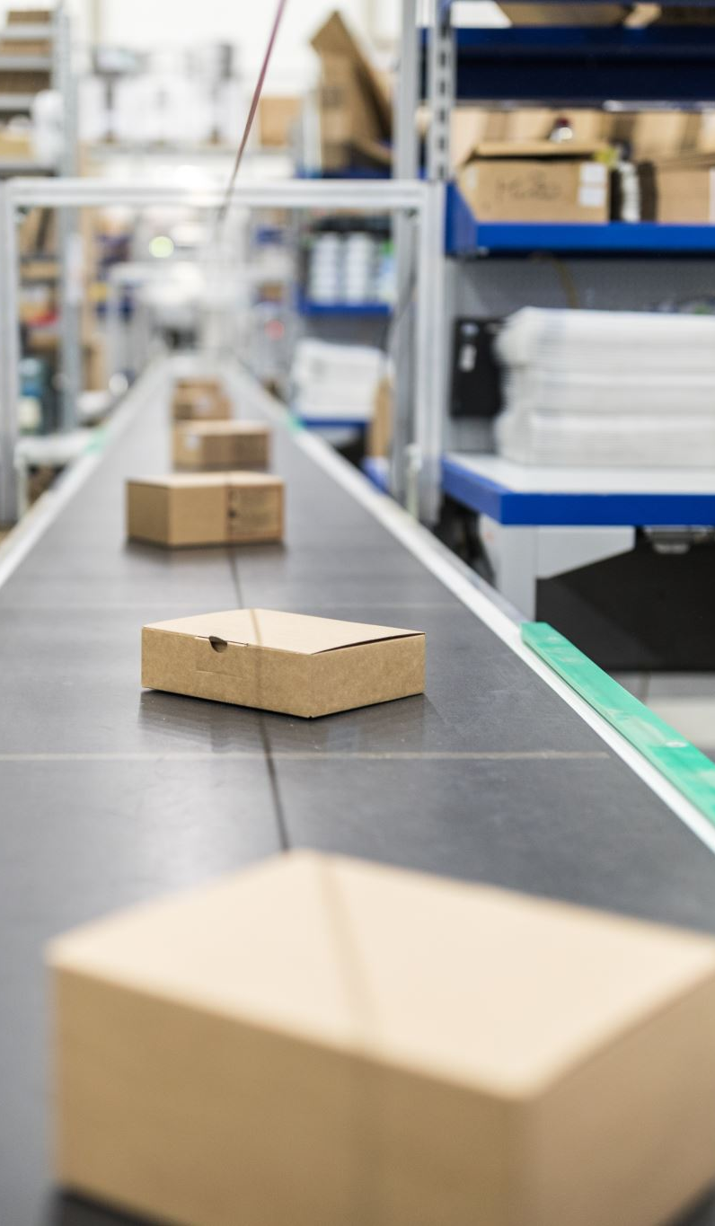
Problem Statement
Retail checkouts require manual barcode scanning, leading to inefficiencies.
Challenges:
Vast product categories with subtle visual differences.
Limited training data for real-world scenarios.
Need for a robust system capable of handling cluttered environments.

Slide 4
Objectives
Develop a dataset for retail product detection.
Train YOLOv11 for high-accuracy, real-time performance.
Optimize the model for speed and performance under cluttered conditions.

Slide 5
Methodology
1. Dataset Preparation:
Images: Single-product and checkout-counter images.
Annotations: Bounding boxes and labels.
2. Model Training:
YOLOv11 model, trained for 200 epochs.
3. Optimization:
Data augmentation and hyperparameter tuning to reduce overfitting.

Slide 6
Dataset Details
Dataset Composition:
500+ images with bounding box annotations.
Types: Controlled single-product images and real-world checkout-counter images.
Challenges Addressed:
Balanced class distribution.
Domain adaptation for realistic scenarios.

Slide 7
Training Results
Model Metrics:
Epochs: 200
Precision: 95%
Recall: 89%
F1-Score: 86%
mAP@0.5: 83.3%
Include confusion matrix and other visual results.

Slide 8
Visualizations
Confusion Matrix (Normalized).
Precision-Recall Curve.
F1-Confidence Curve.
Training Metrics (Loss Curves, etc.)

Slide 9
Key Activities
Dataset annotation and preparation for YOLOv11.
Training and evaluation on large-scale product categories.
Performance testing on real-world scenarios.
Optimization for cluttered backgrounds and domain shifts.

Slide 10
Challenges and Learnings
Challenges:
Tool integration and compatibility.
Managing large datasets.
Handling subtle product differences in cluttered environments.
Learnings:
YOLOv11’s robustness in real-world settings.
Importance of balanced datasets for fine-grained detection.

Slide 11
Conclusion and Recommendations
- Conclusions:
- YOLOv11 achieves high accuracy for real-time retail checkout systems.
- Fine-grained detection is achievable with balanced training data.
- Recommendations:
- Expand dataset with more product categories.
- Explore advanced domain adaptation and augmentation techniques.

Slide 12
Thank You!

